Slide 1
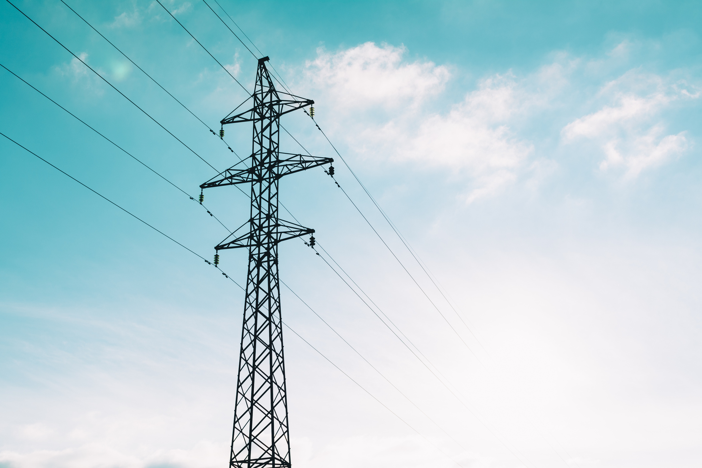
Zeroth Review – Phase I
A Confidence-Driven Probabilistic Machine Learning Framework for Electricity Demand-Supply Gap Forecasting and RAG-Based Energy Planning
Team Members:
Guide Details :
S Udayakumar – 43120227
D Tamilarasu - 43120224
Suganth Kesavan - 43120216
Dr. Kamatchi K. S
Associate Professor
Department of Information Technology

Slide 2
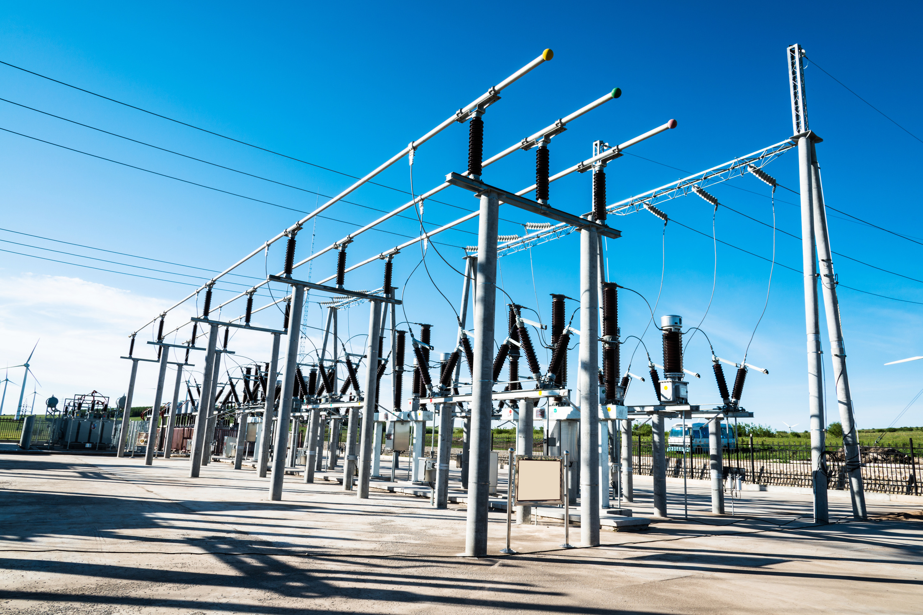
TITLE JUSTIFICATION
Confidence-Driven: Shows how much we can trust the prediction.
Probabilistic Machine Learning: Predicts a range of possible future values instead of only one value.
Demand–Supply Gap Forecasting: Shows whether electricity supply is enough to meet the demand.
RAG-Based Energy Planning:Suggests the best actions to manage electricity efficiently.
Framework: Combines all the steps into one complete system.

Slide 3
ABSTRACT
This project proposes an AI-based framework for electricity demand–supply forecasting and demand–supply gap analysis in Tamil Nadu. The framework utilizes historical electricity demand, source-wise electricity generation, and weather data to forecast future demand and supply. It trains multiple machine learning models and selects the best-performing model for accurate prediction. The predicted demand and supply are then analyzed to identify the future demand–supply gap, along with multi-level confidence intervals (90%, 95%, and 99%) to show how confident the predictions are. Finally, the framework performs confidence-driven risk assessment and provides RAG-based energy planning recommendations to support better electricity planning and decision-making.

Slide 4

PROBLEM STATEMENT
Electricity demand and supply change every day, so they are difficult to predict.
Most existing methods predict only electricity demand and do not forecast electricity supply together.
Current methods give only one prediction and do not tell how confident the prediction is.
Power departments need a better system to plan electricity in advance.
An AI-based system can help make better energy planning decisions.

Slide 5
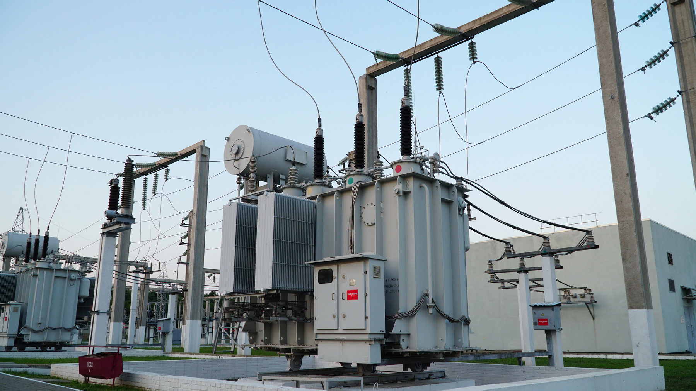
SCOPE& FEASIBILITY
Social:
Helps provide electricity without interruptions.
Helps find future power shortages early.
Improves electricity service for people.
Technical:
Predicts electricity demand and supply for the next three months.
Checks whether the electricity supply is enough to meet the demand.
Gives smart suggestions for better energy planning.
Economic:
Helps reduce electricity costs.
Makes better use of available electricity resources.
Helps electricity departments plan more efficiently.

Slide 6
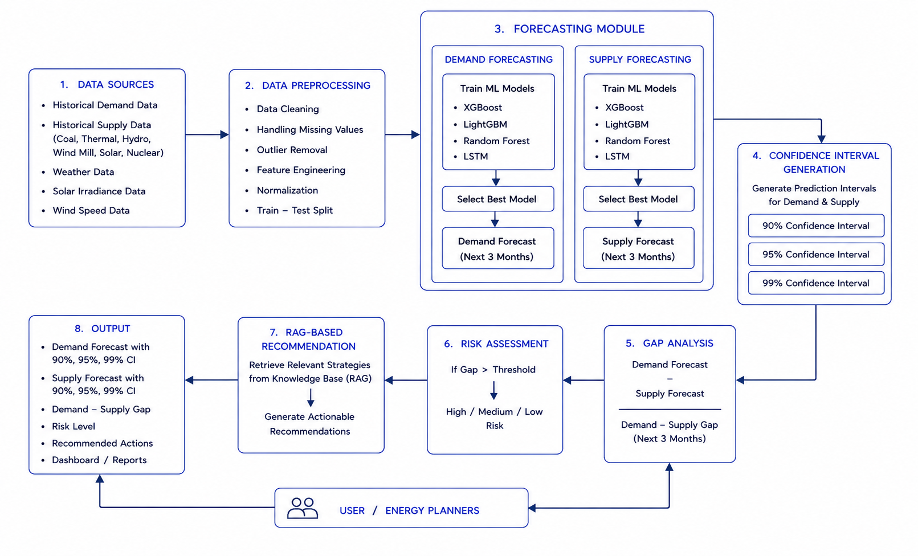
ARCHITECTURE DIAGRAM

Slide 7

EXPECTED OUTCOME
Predicts electricity demand and supply for the next three months.
Finds future electricity shortages or surpluses.
Shows how sure the prediction is using confidence levels (90%, 95%, and 99%).
Identifies the risk level based on the predicted demand–supply gap.
Suggests the best actions for better energy planning using RAG.

Slide 8
REFERENCES
KONSTANTINOS PLAKAS.,&NIKOS ANDRIOPOULOS., “Prediction of Imbalance Prices Through Gradient Boosting Algorithms: An Application to the Greek Balancing Market”, IEEE Access, 2025
S.Amosedinakaran.,&K.Madumathi., “Forecasting the Electricity Demand of Tamil Nadu using Ant Colony Optimization Technique Based on Linear and Non-Linear Models”,IEEE Access,2023
Jitendra Managrea*,&Namit Guptab, “Demonstrate the Predictive Model of Machine Learning in Smart Grids to Process Large Electricity Data According to Power Demand and Supply”,Science Direct,2025
HAMID MIRSHEKALI 1& MOHAMMAD REZA SHADI review on “A Review of Large Language Models for Energy Systems: Applications, Challenges, and Future Prospects.”,IEEE Access,2025
Alexandria Engineering Journal titled “Mathematical and statistical modelling of electricity demand forecasting using artificial neural networks and SARIMA: Implications for energy supply chain planning”,Science Direct,2026

Slide 9
THANK YOU

